Slide 1
MCC (Materials Control Center)
Prepared：Galvin Chen
Date: 2024/04/11
Notes:
參考腳本
Welcome! It is our pleasure to present to you our company. Wistron NeWeb Corp. (WNC)
很榮幸今天有這個機會為各位介紹我們公司: 啟碁科技。

Slide 2
Content
Create Tickets and go get materials at the warehouse
Create scrap material report
Check inventory
Check vender code
NG errors need to be handled
Handle incoming materials
D/C Extend
BOM
Materials Model
PR/IR

Slide 3
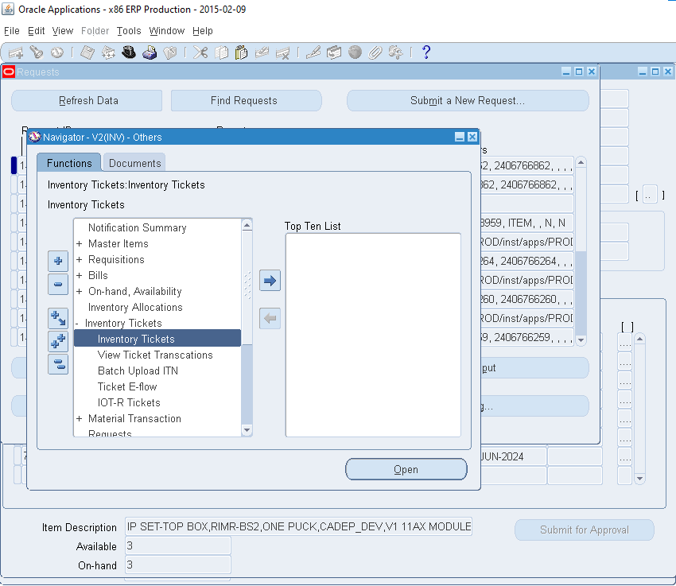
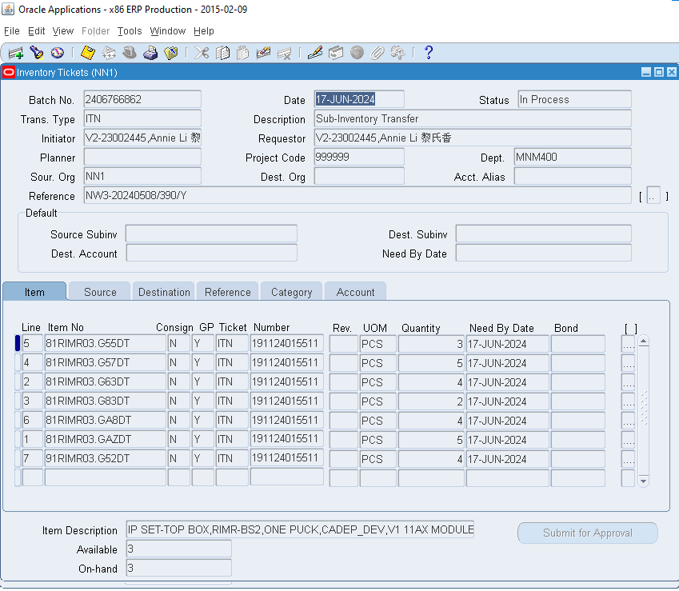
1. Create Tickets and go get materials at the warehouse

Slide 4
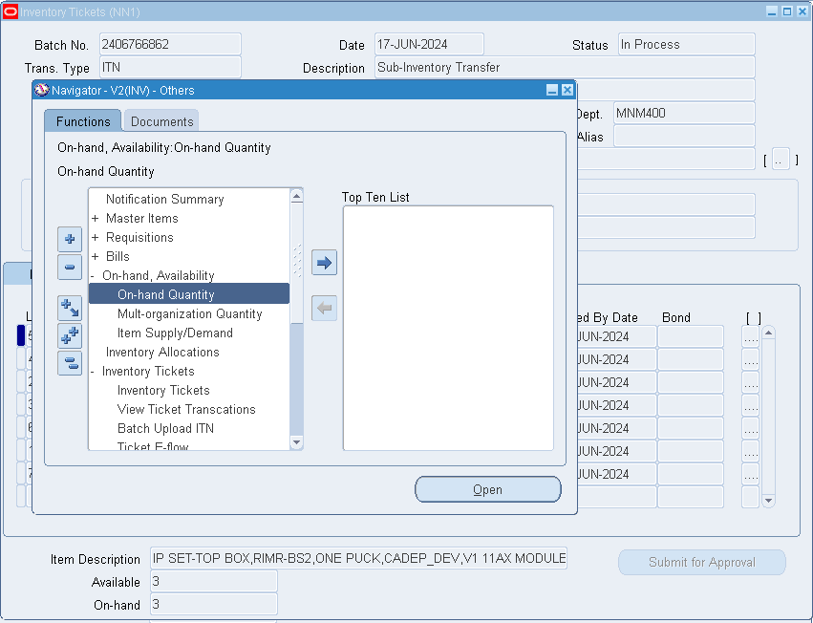
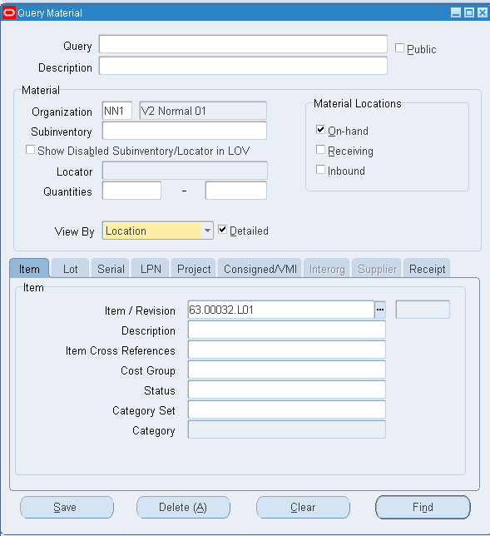
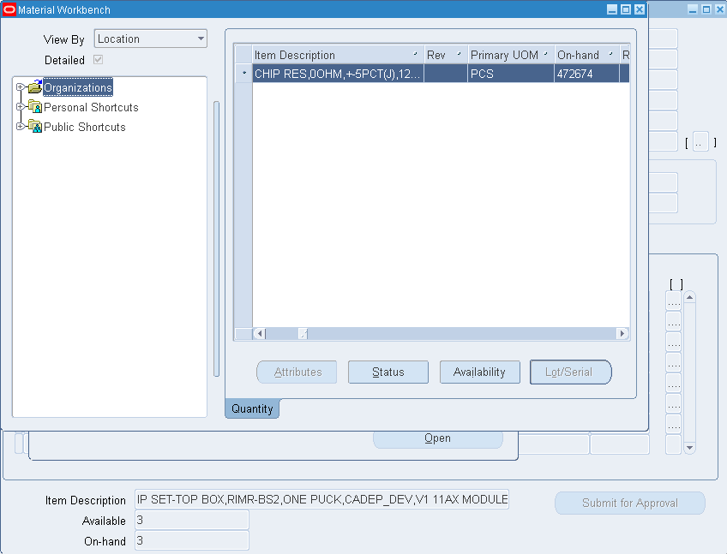
2. Check inventory
Use inventory checking to check the quantity on-hand in the materials warehouse..

Slide 5
5. NG errors need to be handled
No 2S label => print 2S label.
No NCC label or Handwritten NCC label => print NCC label.
Do not roll the materials => Roll materials.
The materials about less than 1m => Joining materials and roll materials.
Expiry D/C => Take 10 pcs to test tin running ATLO.
Not signee.

Slide 6
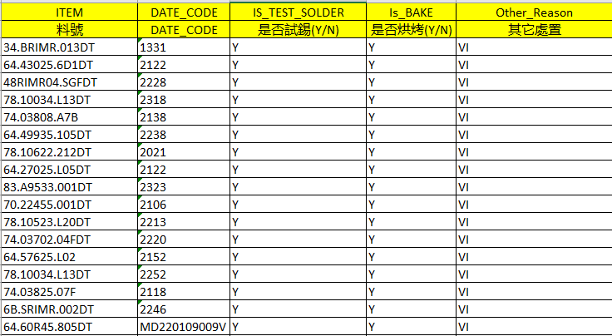
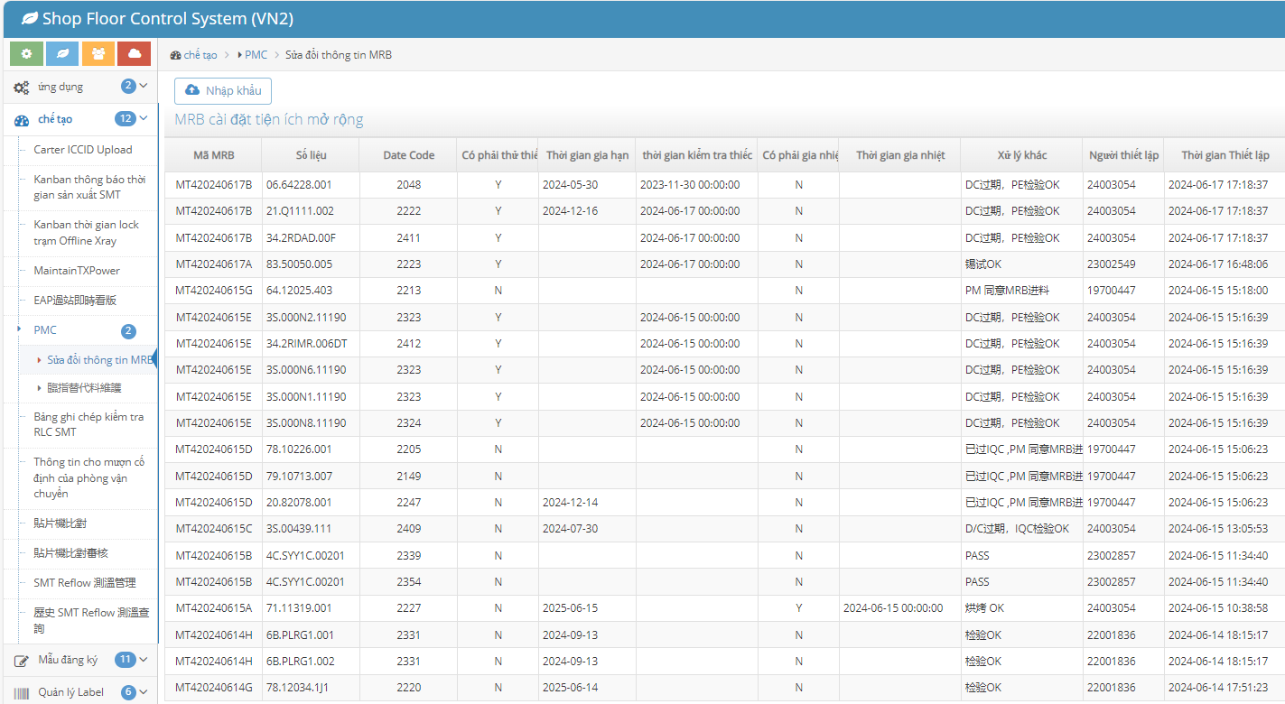
7. D/C extend
Firstly, go to the warehouse to check materials expired D/C. Then enumerate lists that materials to create MRB extend.

Slide 7
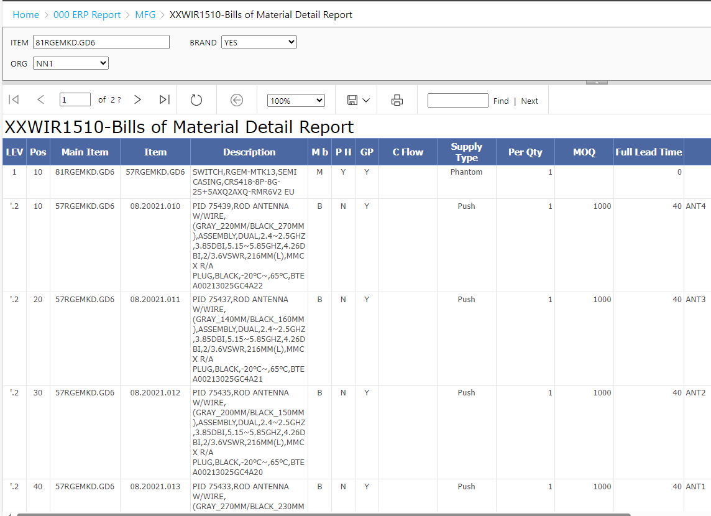
BOM is a list materials of goods. BOM has 2 types: packaging materials and structural materials.
BOM is considered finished products such as 81 or 91. 81 is test run and 91 is already running widely.
8. BOM

Slide 8
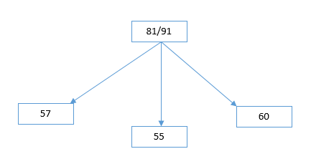
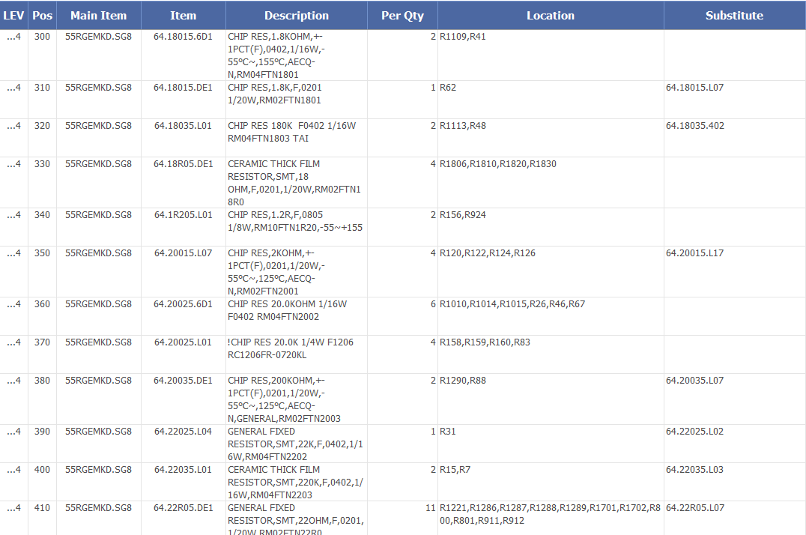
8. BOM
BCBA is usually head 55. This is the completed circuit board.
For BCB is usually head 48. This is an unfinished circuit board.
Purpose of BOM is find substitute materials for shortage materials in the MO.
And locators of these materials can be found in circuit boards.

Slide 9
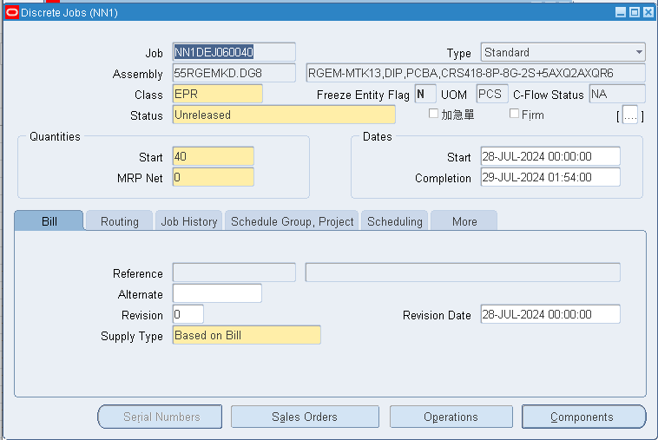
9. Materials Model.
Create a MO with PN: 55RGEMKD.DG8

Slide 10
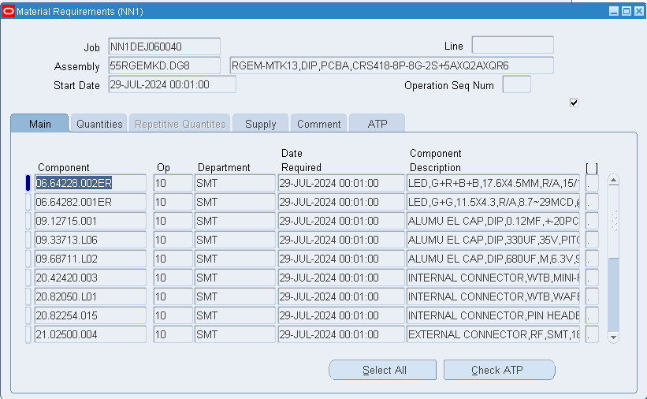
9. Materials Model.
Down MO:
We down MO to ready materials for goods before going onto the production line. To be able to find: shortage materials, substitute materials or materials to purchase.

Slide 11
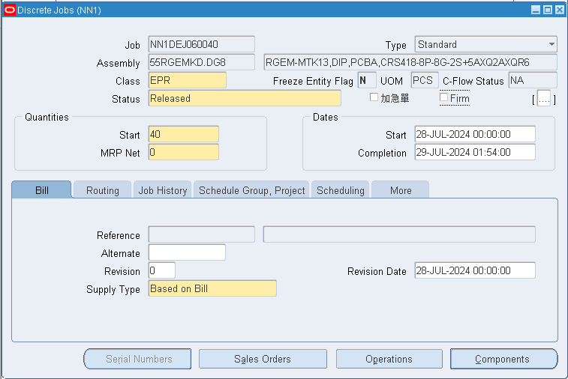
9. Materials Model.
Released MO:
Before letting MO run on production line, we must released MO before 3 days. Example if 01/07/2024 run, we must released on 28/06/2024.

Slide 12
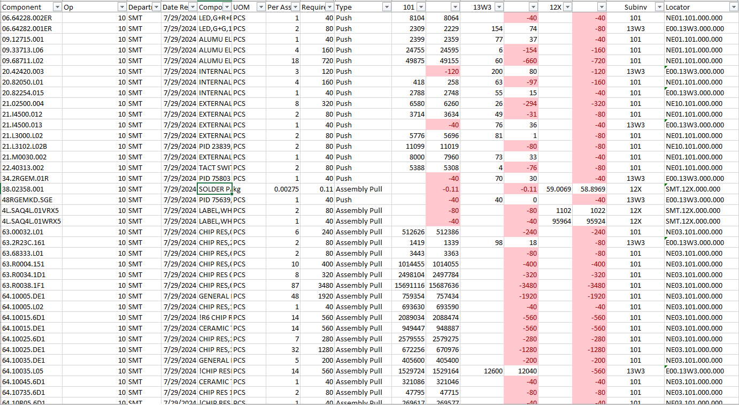
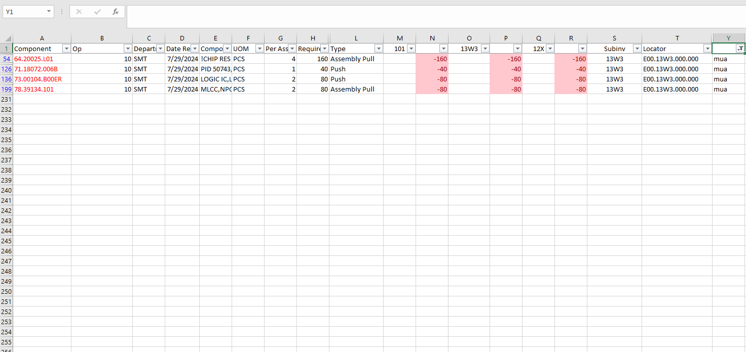
9. Materials Model.
After downloading MO, we move on to the bei Materials.
We find shortage materials and substitute materials in the list materials of the MO. Then down BOM with PN: 55RGEMKD.DG8.
Based on the shortage materials, from the BOM, find substitute materials for the shortage materials.

Slide 13
10. PR/IR
For PR ticket, when we find shortage materials during materials processing, if buying materials from outside. This is material purchase ticket.
For IR ticket, this is internal ticket takes materials from other agencies to Vietnam. Eg: China, Taiwan,...

